Slide 1
DO NOT SHOW
Microsoft Cloud Adoption Framework and the Governance Conversation
Speaker:
CSA, FTA, CAT, TSP, SSP
Primary Audience:
Cloud Architect
Impacted Audience:
Sr. IT Pro/Governance/Security/Privacy/Identity/Network
Usage guide:
This presentation is designed to provide a modular, brief introduction of how CAF can help organizations to master governance in the cloud, preferably on Azure. Use this deck to kickoff the governance discussion with your customer and introduce our other available resources.
Key contact for support:
cafgovhelp@microsoft.com
Additional supporting materials:
Governance MS Docs: https://aka.ms/adopt/govern
Governance Benchmark Tool: https://aka.ms/adopt/gov/assess
Governance Guides: https://aka.ms/adopt/gov/journey

Slide 2
DO NOT SHOW
General Information
This presentation contains several aspects regarding governance theory and the application of governance within Azure
Please tailor it to your individual needs.
(compliance, technical discussions, cloud adoption, cloud governance)

Slide 3
Cloud Adoption Framework Governance Workshop
Speaker
Title

Slide 4
Agenda
Governing Cloud Adoption
Framing a Collaborative Governance Conversation
Assessing Next Steps
Building a governance MVP
Evolve
Take Action

Slide 5
Governing Cloud Adoption

Slide 6
Microsoft Cloud Adoption Framework for Azure
Adopt
Define Strategy
Understand motivations
Business outcomes
Business justification
Prioritize project
Plan
Digital estate
Initial organization alignment
Skills readiness plan
Cloud adoption plan
Ready
Azure readiness guide
First landing zone
Expand the blueprint
Best practice Validation
Migrate
• First workload migration
• Expanded scenarios
• Best practice validation
• Process improvements
Innovate
• Innovation guide
• Expanded scenarios
• Best practice validation
• Process improvements
Govern
Methodology • Benchmark
initial best practice • Governance maturity
Manage
Business commitments
operations baseline • Ops maturity

Slide 7
Objective of this model: Create balance
Speed &
Results
Control & Stability
Notes:
Started with notion that the value of cloud services (speed, agility, innovation, cost, security) is often negatively impacted by existing/legacy enterprise IT processes and practices (Legacy doesn’t work)

Slide 8
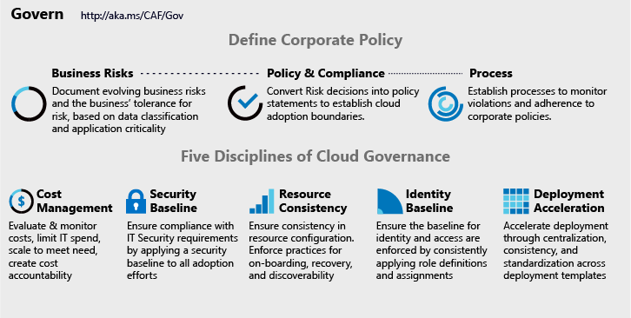
Cloud Adoption Framework Governance Model
Governance End State that fosters trust and builds confidence
Corporate Policy
Governance is a big, intimidating topic. Establish proper scope by mitigating tangible risks through corporate policy.
Cloud Governance Disciplines
Governance is a team sport. Empower multiple team members by decomposing corporate policy changes into five actionable disciplines.
Governance MVP
Start small. Establish a foundation that can quickly evolve as cloud adoption and cloud governance mature. Mitigate tangible risks identified in the cloud adoption plans.
Cloud Governance Team
A team of governance minded cloud architects can evolve these disciplines, ensure governance consistency, and accelerate deployment.

Slide 9
Making Governance Actionable with Native Tools
Azure Monitor
Azure Blueprints
Azure Policy
Azure Cost Management
Azure Advisor
Azure Portal
Azure EA Content Pack
Azure Blueprint
Azure Policy
Resource Grouping & Tagging
Resource Manager Templates
Azure Advisor
Azure DevOps
Azure Site Recovery
Azure Backup
Azure Automation
Azure Blueprints
Azure Policy
Azure Security Center
Azure Sentinel
Subscription Design
Encryption
Hybrid Identity
Azure Networking
Azure Automation
Azure Blueprints
Azure Policy
Azure Monitor
Azure Advisor
Resource Manager Templates
Resource Graph
Management Groups
Azure Blueprints
RBAC
Azure AD
Azure AD B2B
Azure AD B2C
Directory Federation
Directory Replication

Slide 10
Integrating 3rd Party Tools
Monitoring 3rd parties
OpsCompass
Cost Management 3rd parties
HashiCorp Terraform
Deployment 3rd parties
Nagios
HashiCorp Terraform
devops tools like Chef, Puppet, Zabix
Security baseline 3rd parties
Splunk
HashiCorp Vault
Discovery, onboarding, and recovery 3rd parties
ServiceNow
HashiCorp Terraform
3rd party identity providers
HashiCorp Vault
Notes:
What third parties can be used to accomplish similar goals?

Slide 11
Before we begin…

Slide 12
Identifying business risks and compliance needs
Business risk
Compliance

Slide 13

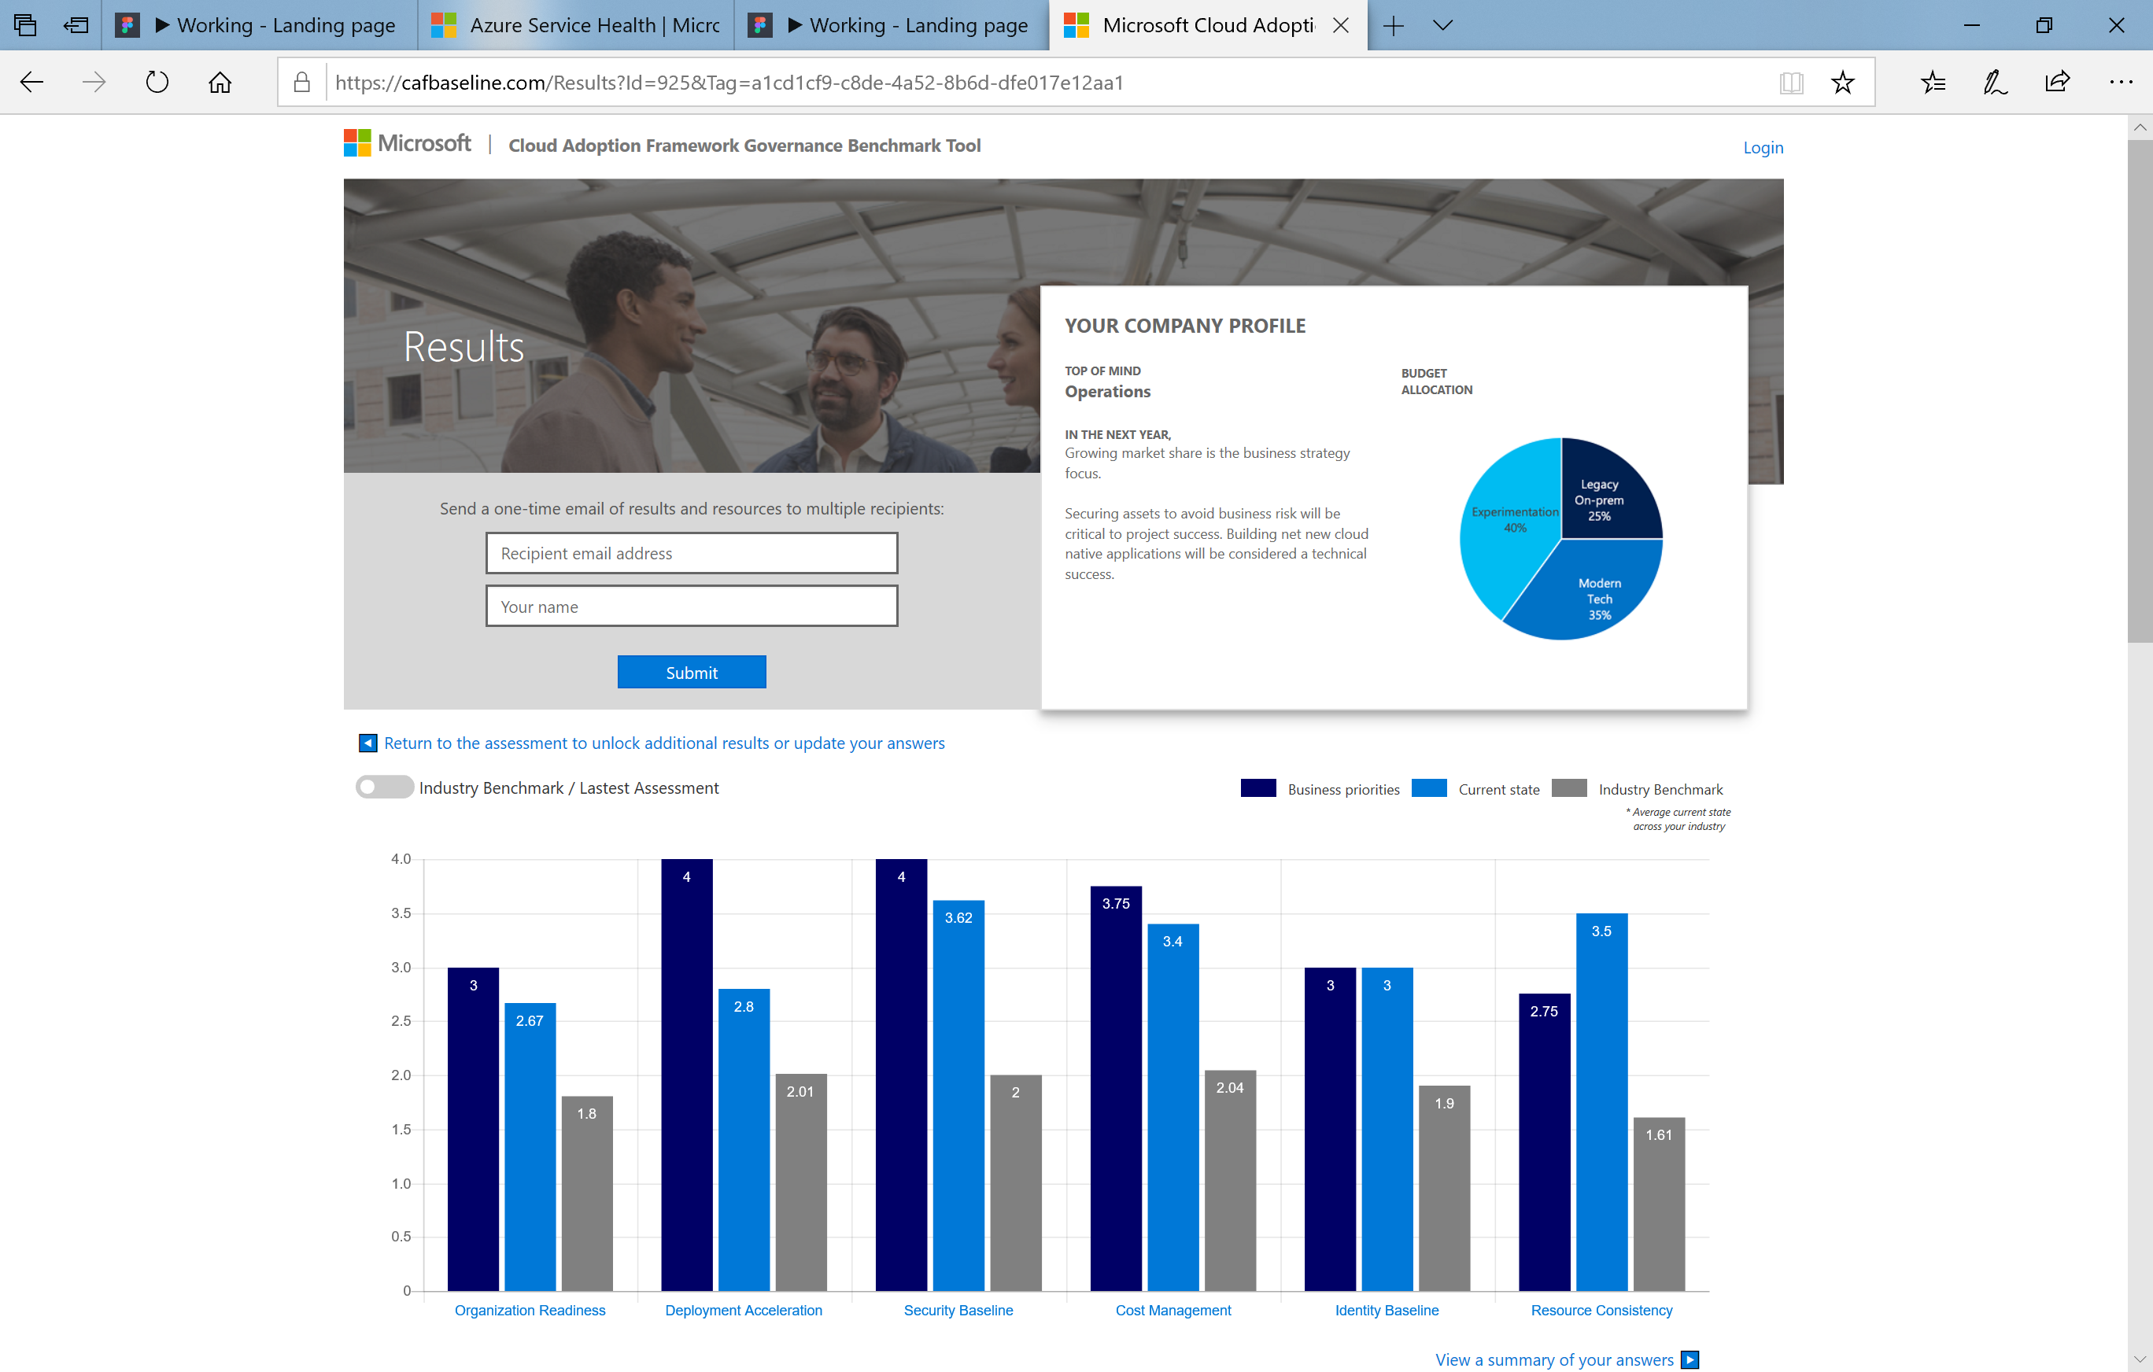
Understand your current state and prepare for your cloud journey using
The Governance benchmark tool http://aka.ms/adopt/gov/assess

Slide 14
Azure Policy Sample showcase

Slide 15
Based on the outcome of the benchmark results, lets drill into the disciplines for which to build the minimal viable product (MVP)
Cost Management
Security Baseline
Identity Baseline
Resource Consistency
Deployment Acceleration

Slide 16
What and Why of Governance MVP
What is a Governance MVP?
The smallest unit of configuration management and policy management implementation required to establish a scalable foundation
Why establish a governance MVP?
A rapidly implemented, yet scalable starting point creates balance. This model allows existing IT functions to mature at their own pace, without slowing business results. As they mature, IT policies can be applied consistently.
Notes:
Talk track:
The CAF model to governance is a way of approaching governance that allows us to decompose complex and emotional topics into smaller units of actionable change.
In the sections on Defining Corporate Policy, we change the topic from alignment to current IT governance requirements to a realistic look at tangible risks created by cloud adoption. Those risks can generate policy & compliance statements and recurring processes, which augment existing IT Governance Policy.
Actioning on those policy statements, is done in one of five buckets of activity that span the governance conversations. In each of the five disciplines, the Cloud Governance Team leverages the Configuration Management capabilities of the Azure Govern and Azure Manage tools to help IT Governance, IT Security, Identity, and Networking teams apply requirements consistently across all Azure adoption.
In this session, we will focus on the tools that establish a foundation for governance in Azure, which can be used to accelerate all five disciplines. These tools will aid in ensuring that the requirements of each discipline is consistently applied, audited, & enforced.

Slide 17

Traditional approach
Sacrifice Speed for Control
Developers
Cloud Custodian /
Engineers responsible for Cloud environment
Operations
Notes:
SMART governance: enabling velocity through native controls
Showing how policy, cost, arm security still allows the development teams to execute at the velocity that the need while IT manages as a custodian natively without getting in the way
When it comes to cloud management platforms and brokers, we are approaching this differently. We are integrating the governance into the cloud, rather than a shim between the cloud and the customer.

Slide 18
Cloud-native governance
Speed and Control
Developers
Cloud Custodian Team
Built-in controls through policy instead of workflow
Operations
Notes:
SMART governance: enabling velocity through native controls
Showing how policy, cost, arm security still allows the development teams to execute at the velocity that the need while IT manages as a custodian natively without getting in the way
When it comes to cloud management platforms and brokers, we are approaching this differently. We are integrating the governance into the cloud, rather than a shim between the cloud and the customer.

Slide 19



Built-in modern governance
Speed and control
Management Groups
Blueprints
Cost Management
Templates
Development
Cloud Custodian
Speed
RBAC
Control
Resource
Graph
Policies
Mgmt as code
Agile Development
Policies
Security
Cost Control
Policies
Azure Governance
Notes:
That is why we are announcing a set of governance capabilities that are fully embedded on the Azure platform to provide control without losing speed.
Azure Blueprints enables development teams to move fast by providing a way to repetitively create fully governed environments in a matter of minutes.
Azure Policies are integrated now with Azure Devops, providing management as code capabilities, so approval processes don’t slow down development.
All this gets enhanced by management groups, which allow blueprints and policies to scale across your organization, resource graph which enables visibility across all your resources for more efficient inventory management, and Azure cost management which enables you to get more value out of the cloud by helping you save money.

Slide 20
Cost Management

Slide 21
How are you thinking about Cost Management
What are the cost management concerns
Do you have a centralized way of tracking spend
How do you monitor and manage cloud costs
What are the policies related to resource assignment and tagging?
Do teams have the ability to dynamically size and scale assets for demand, how does that impact cost control?
Is there an ongoing process to address optimization?

Slide 22
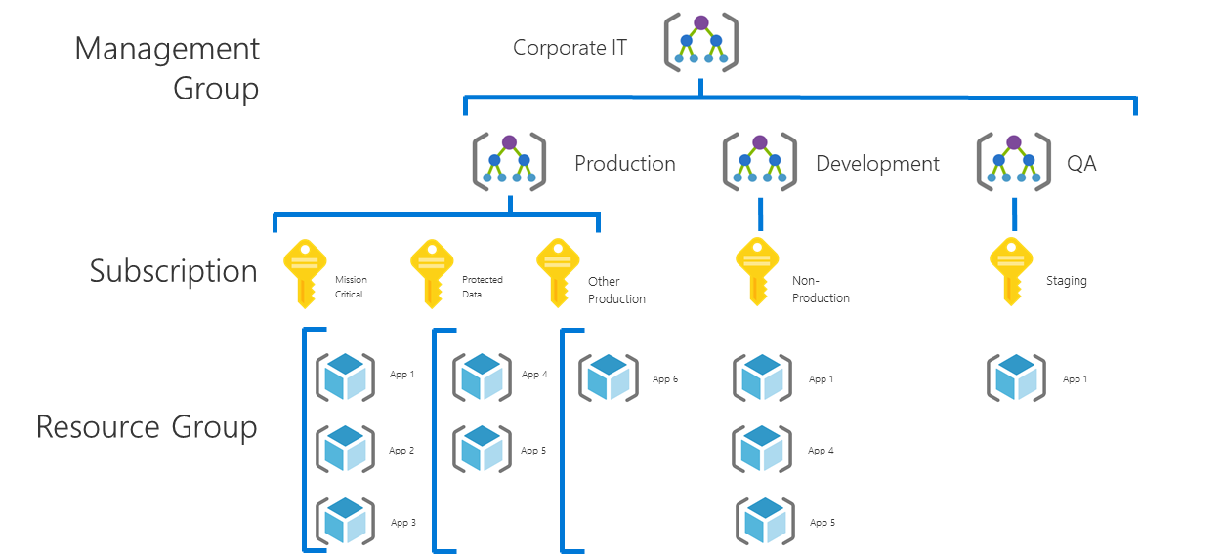
Cost Management
Evolving the MVP: Cost Control
Current State MVP
Risk discovered
Costs are mushrooming. The CFO is concerned with budget overrun. A report is needed to show spend by business unit. Controls are needed to limit expenses.
Exercise
What changes or additions would you make to the “Governance-MVP”?
What other tools in Azure could be used to extend the MVP?
Extra points, if your solution includes a way to reduce the risk of extra spend in the future using policies
Azure Blueprint named “Governance-MVP” .
Azure Policy as follows:
Resource tagging require values for Department/Billing Unit, Geography, Data Classification, Criticality, SLA, Environment, Application Archetype, Application, and Application Owner.
The value of the Application tag should match the name of the resource group.
Notes:
CSA, FTA, PSS, SSP or Partner can help modify the initial design based on Decision Guidance in CAF.
Review and adjust this pattern to fit before presenting to the customer.

Slide 23
Design Evolution A few options to consider
Cost Management
Report spend by Business Unit
Generate Azure Cost Management (&/or Cloudyn) reports grouped by the Business Unit tag.
Reduce overall spend
If possible, start with a review of AHUB and RI options for immediate potential cost reductions.
Review Azure Advisor and Azure Cost Management feedback to suggest tuning options to each application owner.
Generally, a holistic review of spend will identify a few key SKUs that are consuming a large percentage of the Azure costs. Suggest the application owners begin by tuning those large instances.
Bonus Points: Reduce Future Spend
Once re-sized, avoid future spend by creating an Azure policy to block the use of any unused SKUs that have a higher unit cost.
If the governance team has a strong relationship and regular cadence with cloud adoption teams, a second suggestion could prove valuable. For all prod subscriptions, establish a deployment plan including the SKUs to be deployed. Block the use of any SKU not on the deployment plan. This reduces overspending from unplanned vertical scaling. This approach also promotes the use of more easily automated horizontal scaling.

Slide 24
Security Baseline

Slide 25
How are you thinking about Security Baseline
How are you handling security / protection of data
What are the policies applied to networks
How are you handling elevated rights within the environment
Can developers use any and all services in Azure?
Have you defined rules around who can create new management groups and subscriptions?
Are you reviewing processes on a regular cadence with other stakeholders

Slide 26
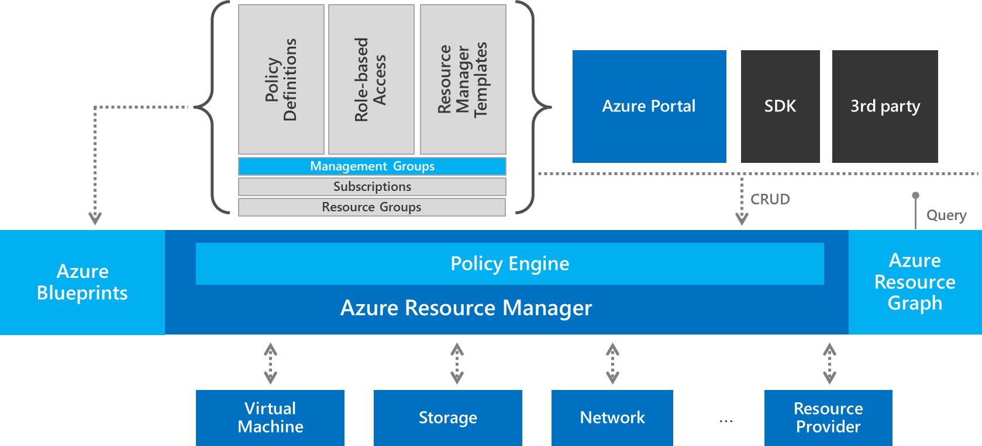
Governance Design Evolution A few options to consider
Security Baseline
Implement Azure Security Center
Automate Patching to ensure patch compliance
Policy
Require encryption on storage accounts
Enforce application tier vNets
Enforce NSGs at each tier
Block User Defined Routing
Apply Guest Configuration policies
ARM Templates
Define a firewall configuration
Blueprint
Apply ASC, Policy, and ARM configurations

Slide 27
Identity Baseline

Slide 28
How are you thinking about Identity Baseline
What connectivity are you establishing between Azure and your telco provider
What authentication methods are you applying for your users
Do you use O365 and Active directory today?

Slide 29
Resource Consistency

Slide 30
How are you thinking about Resource Consistency
Will you allow users to create assets and resources from the Azure portal
What is the process for selecting / approving resources which can be used?
What are your resource classification rules and requirements?
What tooling will you use to facilitate asset creation?
How are you sizing your assets?
Have you planned your Azure hierarchy?
What is the governance review and audit process?

Slide 31
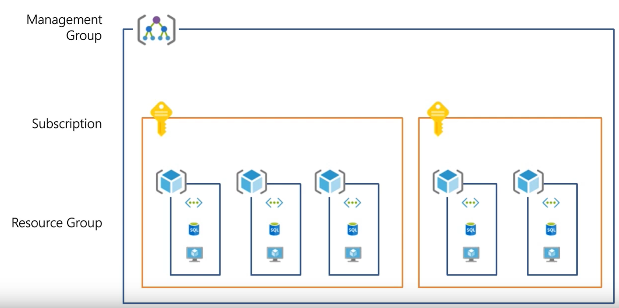
Resource Consistency
Resource Organization
The basic foundation of all governance practices
Management Groups: To reflect security, operations and business/accounting hierarchies
2. Subscriptions: To group similar resources into logical collections
3. Resource Groups: To further group applications or workloads into deployment and operations units

Slide 32
Resource Consistency
Current State
- Sales and operations in multiple geographies – global customer base
- Three business units
- Budget is a complex matrix across business unit and geography
- 20 privately-owned datacenters around the globe
- Loosely-coupled global WAN
- All end user email accounts are in Office 365
- The CIO and CFO want to move two data centers and 5,000 VMs in 36 mo
- There is no interest in investing in cloud governance, but a few cloud architects want to get ready for the inevitable.
IT governance policy states that customer personally identifiable information (PII), financial data, and mission critical workloads must be hosted on assets owned directly by the company. The CIO is working on changing this policy.
Define an MVP
Resource Organization
Resource Governance
Exercise: Define a Governance MVP to fit this customer
How would you structure the Management Groups based on this discovery?
How would you divide subscriptions within MGs?
How would you define resource groups?
What Resource Governance Tools would you put in place?

Slide 33
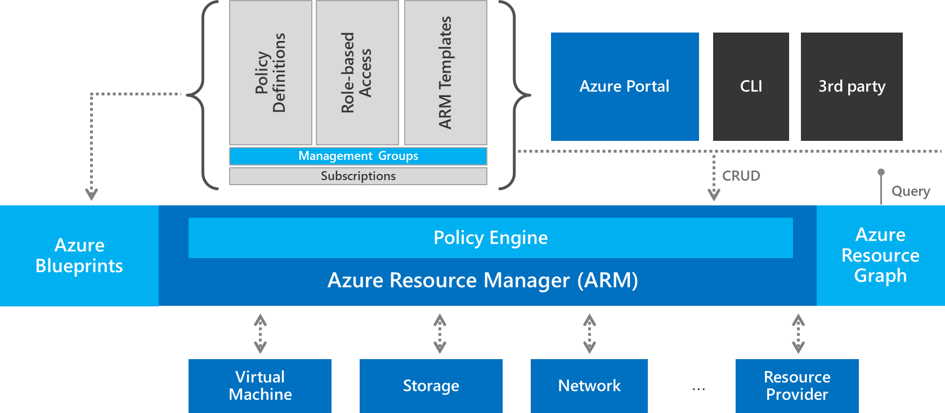
Resource Consistency
Actionable Design
Building the right MVP
Governance MVP Design
The following is an example of what one companies MVP design could include.
Create the Subscription and Management Group, adhering to the naming standards and hierarchy decisions.
Create an Azure Blueprint name “Governance MVP”. Azure Resource Management templates and Azure Policy will be created and added to the Blueprint as assets.
Enforce RBAC requirement for the subscription in the Blueprint
Create an Azure Resource Manager Template for a VPN Gateway (To be used as needed)
Create an Azure Policy to apply or enforce the following:
Resource Tagging should require values for Business Function, Data Classification, Criticality, SLA, Environment, and Application.
Resource Grouping per Application Archetype should align to the application tag
Software Defined Network if the environment lists the Environment tag as DMZ (Demilitarized Zone), ensure the proper VPN is configured
Identity validate role assignments for each resource group and resource
Nether logging, reporting, nor encryption require a policy at this time
Notes:
CSA, FTA, PSS, SSP or Partner can help modify the initial design based on Decision Guidance in CAF.
Review and adjust this pattern to fit before presenting to the customer.

Slide 34
Resource Consistency
Azure Governance Architecture
Starting point for Governance MVP
Policy Definitions
Role-based Access
Resource Manager Templates
Management Groups
Subscriptions
Azure Portal
SDK
3rd party
Environment Factory: Deploy and update cloud environments in a repeatable manner using composable artifacts
Resource Groups
CRUD
Query
Azure Blueprints
Policy Engine
Azure Resource Graph
Azure Resource Manager
2. Policy-based Control: Real-time enforcement, compliance assessment and remediation at scale
3. Resource Visibility: Query, explore & analyze cloud resources at scale
Virtual Machine
Storage
Network
…
Resource Provider

Slide 35
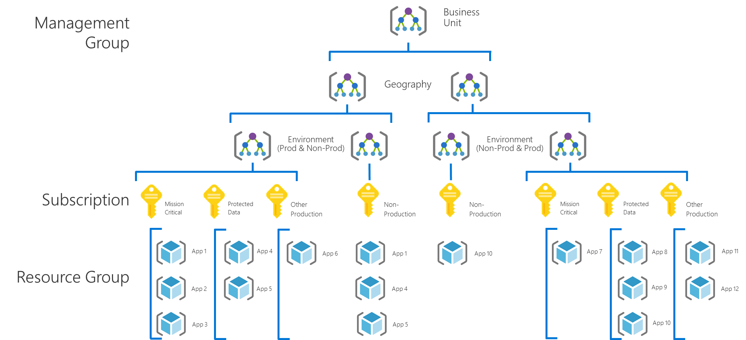
Governance MVP A few options to consider
Resource Consistency
Resource Governance:
Create an Azure Blueprint named “Governance-MVP” .
Enforce that users can only authenticate against existing role-based access control (RBAC) implementation.
Create an Azure Policy to apply or enforce the following:
Resource tagging should require values for Department/Billing Unit, Geography, Data Classification, Criticality, SLA, Environment, Application Archetype, Application, and Application Owner.
Publish the “Governance-MVP” blueprint to each management group and assign it to each subscription
Resource Organization:
Build only what you need, but grow to this hierarchy.
MG Hierarchy: Business Unit, Geography, Environment
Subscription: Per Application Category
Resource Groups: Per Application

Slide 36
Deployment Acceleration

Slide 37
How are you thinking about Deployment Acceleration
Of your environment today how much automation do you apply to current operations?
What do you do around configuration management and avoiding configuration drift

Slide 38
Microsoft is here to help evolve
Cloud Governance

Slide 39
Take Action

Slide 40
Next Steps

Slide 41
Thank You

Slide 42
Appendix

Slide 43
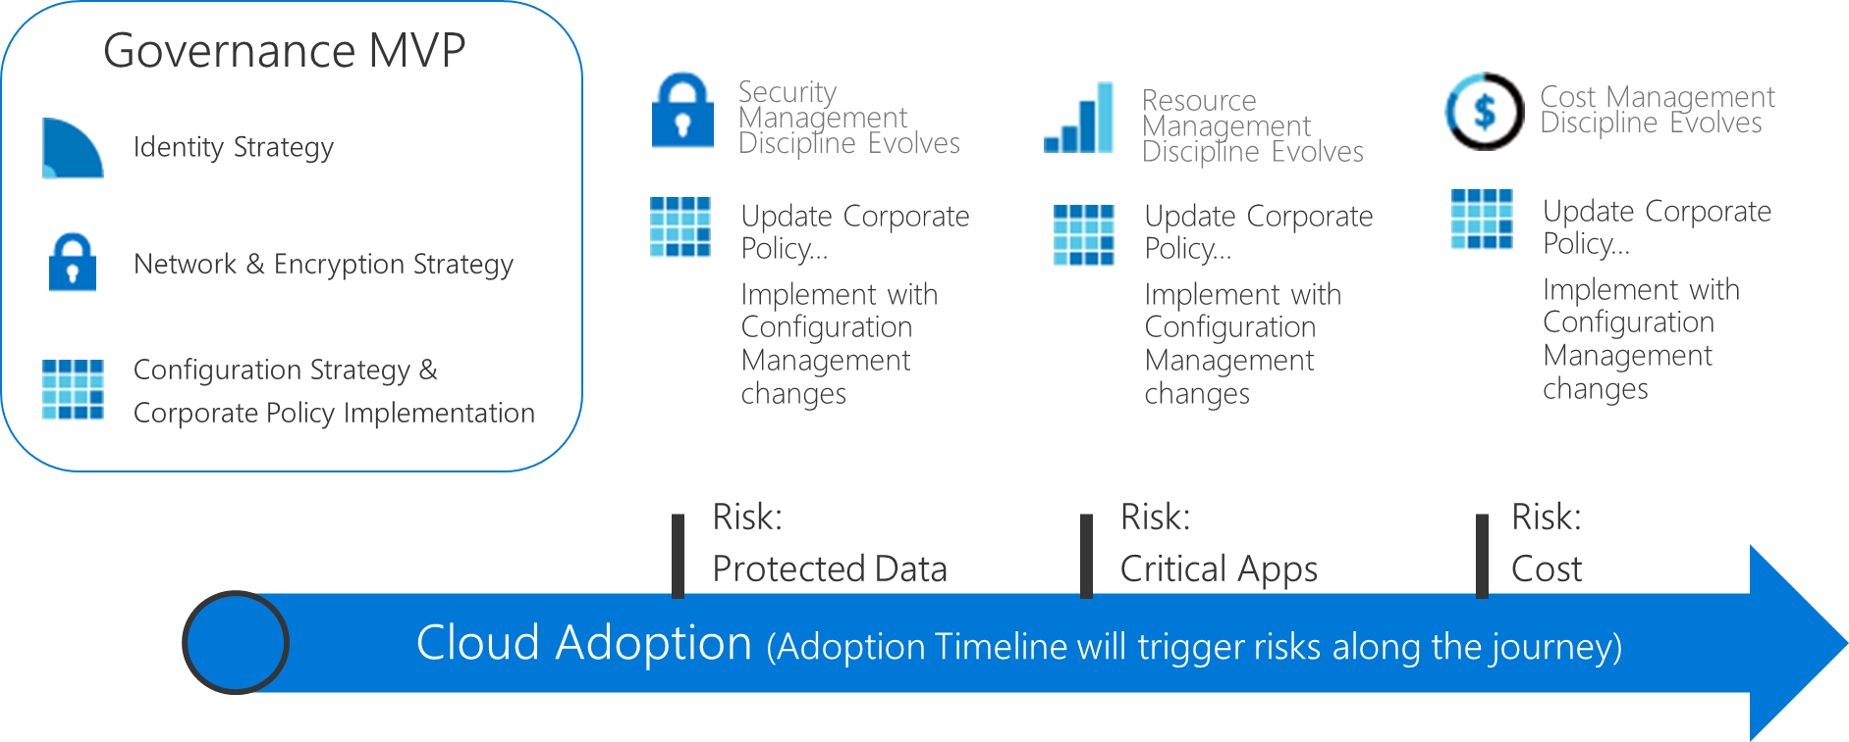
Incremental Governance Execution
DON’T build Governance End State
Governance MVP
Start small. Establish a foundation that can quickly evolve as cloud adoption and cloud governance mature. Mitigate tangible risks identified in the cloud adoption plans.
Risk Evolutions
As additional iterations of cloud adoption are planned, the risk profile will change. The Cloud Governance Team monitors those adoption plans to identify risks and evolve corporate policy statements.
Notes:
Talk track:
The CAF model to governance is a way of approaching governance that allows us to decompose complex and emotional topics into smaller units of actionable change.
In the sections on Defining Corporate Policy, we change the topic from alignment to current IT governance requirements to a realistic look at tangible risks created by cloud adoption. Those risks can generate policy & compliance statements and recurring processes, which augment existing IT Governance Policy.
Actioning on those policy statements, is done in one of five buckets of activity that span the governance conversations. In each of the five disciplines, the Cloud Governance Team leverages the Configuration Management capabilities of the Azure Govern and Azure Manage tools to help IT Governance, IT Security, Identity, and Networking teams apply requirements consistently across all Azure adoption.
In this session, we will focus on the tools that establish a foundation for governance in Azure, which can be used to accelerate all five disciplines. These tools will aid in ensuring that the requirements of each discipline is consistently applied, audited, & enforced.

Slide 44
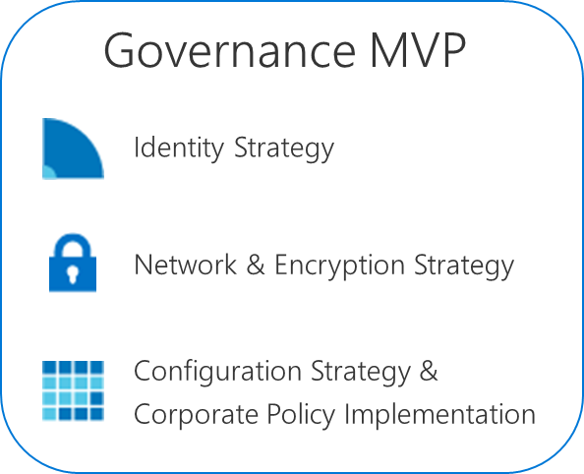
Risk-Driven Evolution
Keep the big picture in mind, but align tasks based on immediate tangible risks
Release
Release
Release
Release
Release
Milestone
Cloud Adoption Timeline
Predict, don’t guess
We could make educated guesses about future, milestone risks. We can accurately predict those risks per release.
Release composition
Each release represents a continuum of activities from planning to completion. Releases often span multiple iterations of effort or sprints.
During planning, the team should be able articulate a fairly accurate description of the assets involved, workload criticality, data classification, deployment approach, and budget. These may change in the release, but are close enough for a safe governance prediction.
Release
Plan
Complete

Slide 45
Execution of Incremental Governance
Integrating into release cycles
Governance Integration
During release planning, the Cloud Governance Team seeks to understand the release plan, so they can better integration.
The following high-level questions can help:
When will this release be completed?
What risks are introduced by this plan?
What needs to change to mitigate the new risks?
Governance Evolution
The Cloud Governance Team then asks deeper questions to establish a governance release plan.
Will application criticality in this release impact policies regarding IT Operations or Cloud Operations?
Will data classifications in this release impact policies regarding IT Security?
Release Plan
Will the suggested deployment impact pricing, planned spend, or cloud budget?
Will the application requirements impact identity policies or implementation?
Will any of these answers impact configuration management implementations or require the implementation of new corporate policies?

Slide 46
Critical Partners
Building the right MVP
Governance is a team sport
Defining a governance MVP creates an opportunity to partner with existing IT functions, in manageable implementations.
Cloud Adoption: understand the plan for adoption, deployment, or migration to the cloud
IT Security: Understand initial identity, encryption, and networking requirements
Identity: Align to hybrid identity implementation
Network: Align to existing network criteria
Storage: Align to encryption practices
Remember Tangible Risks
An MVP doesn’t attempt to fulfill all requirements. Instead, collaborate with each team to identify the minimum requirements based on the current cloud adoption plan.

